Slide 1
CMPSC-131
T.10

Slide 2
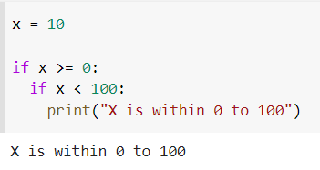
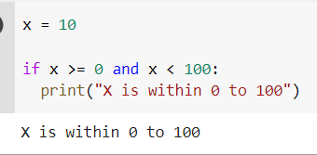
Nested ifs to AND

Slide 3
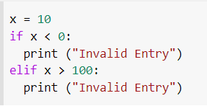
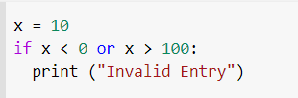
Nested ifs to OR

Slide 4
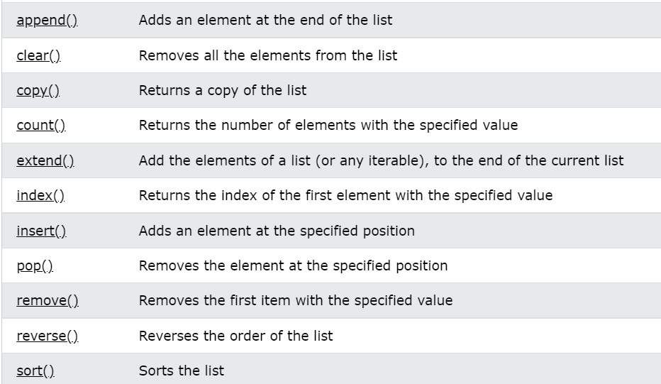
Member Functions:

Slide 5
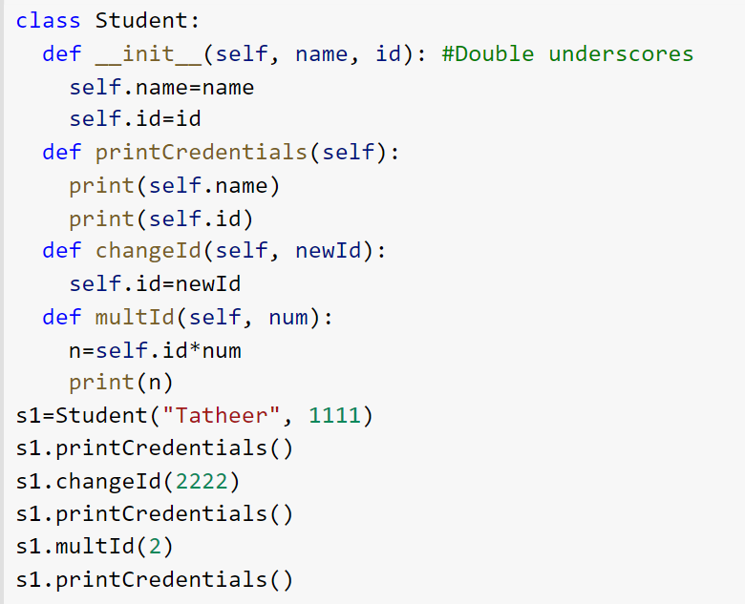
Lab-8 and Objects :

Slide 6
Lab-8 and Objects :
https://colab.research.google.com/drive/1m0XOsSHgkB6pe1LQ1EjLxjP5_k4sssCm?usp=sharing

Slide 7
Quiz Code
billBurr

